Slide 1
Getting Started with SQL Server

Slide 2
Agenda
Introduction to Database
Introduction to SQL Server
Setting Up SQL Server 2019
SQL Server Components and Services
SQL Server Databases and Tables
SQL Keys
SQL Commands
SQL Constraints

Slide 3
Introduction to Database
A database is a set of related data.
An organized collection of data.
The stored data is managed and query by a DBMS.

Slide 4
Types of Database
Types of Database
DBMS
(File System, XML, FoxPro)
RDBMS
(SQL Server, Oracle, DB2, MySQL)
NoSQL
(Cosmos DB, MongoDB, CouchDB, Redis)

Slide 5
Introduction to SQL Server
Microsoft SQL Server is a RDBMS developed by Microsoft.
Primarily designed and developed to compete with MySQL and Oracle databases.
Designed to run on a central server so that multiple users can access the same data simultaneously.
Accessible through any application and for any developer.
Now SQL Server 2019 is a unified data platform with Apache Spark and Hadoop Distributed File System (HDFS).

Slide 6
Version History of SQL Server
SQL Server 2000
SQL Server 2008
SQL Server 2012
SQL Server 2016
SQL Server 2019
SQL Server 2005
SQL Server 2010
SQL Server 2014
SQL Server 2017
Windows, Linux, Containers

Slide 7






SQL Server Editions
SQL Server Editions
Express
(Free, small database)
Developer
(Dev, test, non- production db)
Web
(Low total-cost-of- ownership)
Standard
(Mid tier application db)
Enterprise
(Large scale and mission Critical)

Slide 8



Setting Up SQL Server 2017/2019
Windows
Linux
Docker
Kubernetes
SSMS
Azure Data Studio
Platforms
Tools

Slide 9
Verifying SQL Server Environment

Slide 10
SQL Server Components and Services
SQL Server Components and Services
SQL Server Browser
(Listen and connects to instance)
Full-Text Search
(running full-text queries )
VSS Writer
(backup and restoration)
SSAS
(Data analysis, and Machine Learning)
SSRS
(Reporting and integration with Hadoop)
SSIS
(Extract, Transform data from one source to another)
Database Engine
(storage, processing, security)
SQL
Server
(starts, stops, continues an instance)
SQL
Server Agent
(Task scheduler)

Slide 11
System Defined Databases
System Defined Databases
resource
(read-only database)
master
(system level information)
model
(template for all databases)
msdb
(scheduling alerts and jobs)
tempdb
(temporary objects or result sets)

Slide 12
Demo :
Creating A Database

Slide 13
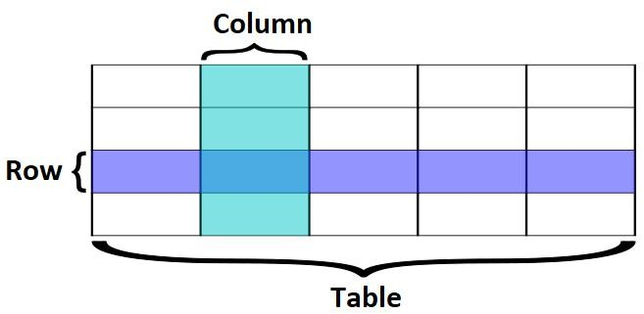
Database Table

Slide 14
Demo :
Creating A Table

Slide 15
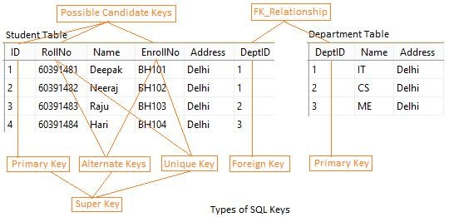
SQL Keys
SQL Keys
Super Key
Candidate Key
Primary Key
Alternate Key
Composite Key
Unique Key
Foreign Key

Slide 16
Demo :
SQL Keys

Slide 17
SQL Commands
SQL Commands
DDL (CREATE, ALTER,
DROP and TRUNCATE)
TCL
(SAVEPOINT, ROLLBACK and COMMIT)
DML (INSERT, UPDATE,
and DELETE)
DQL (SELECT)
DCL
(GRANT and REVOKE)

Slide 18
Demo :
DDL Commands

Slide 19
Demo :
DML Commands

Slide 20
Demo :
DQL Commands

Slide 21
Demo :
DCL Commands

Slide 22
SQL Constraints
SQL
Constraints
Primary Key Constraints
Foreign Key Constraints
Unique Key Constraints
Default Constraints
Not Null Constraints
Check Constraints

Slide 23
Demo :
SQL Constraints

